Slide 1

CSE-5335: Insta wash
Vineeth Kumar Ananthula - 1001953922
Pavani Earati – 1001953926
Sai Santhosh Bhattaram – 1001874167
Section: 5335-003
FALL 2021

Slide 2

PROJECT 5 Demo
Pages before Login

Slide 3

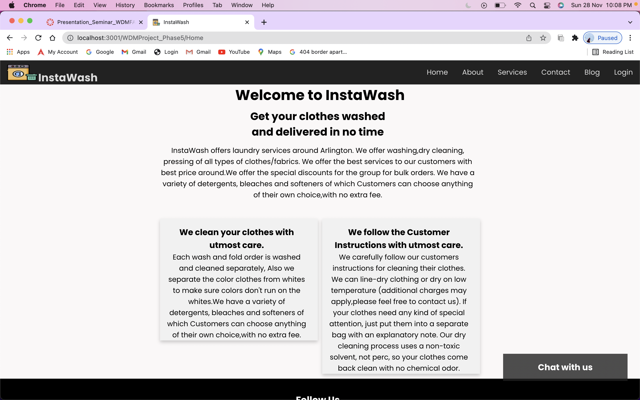
PROJECT 5 Demo
Page: Home
The front end of the application is developed in react and CSS & Back end is developed in PHP(Laravel framework).
Home page has the information of the Insta wash system.

Slide 4
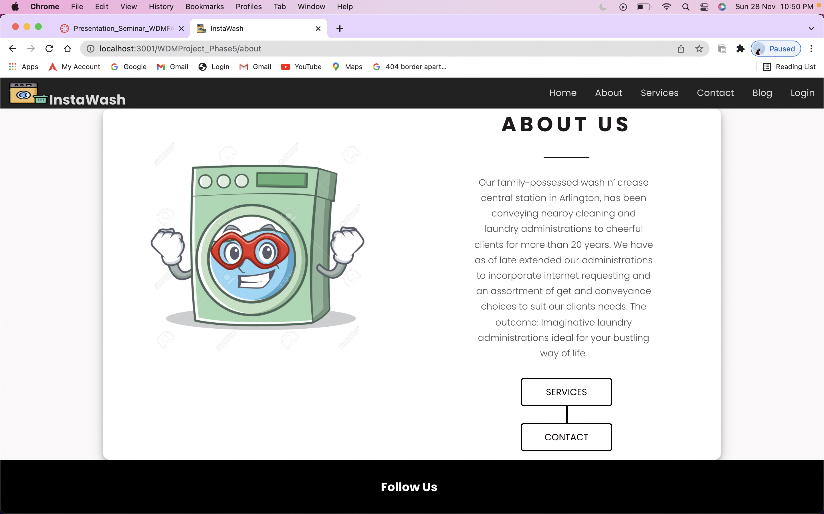
PROJECT 5 Demo
Page : About Us
About us has the details and whereabouts of the Insta wash system.

Slide 5
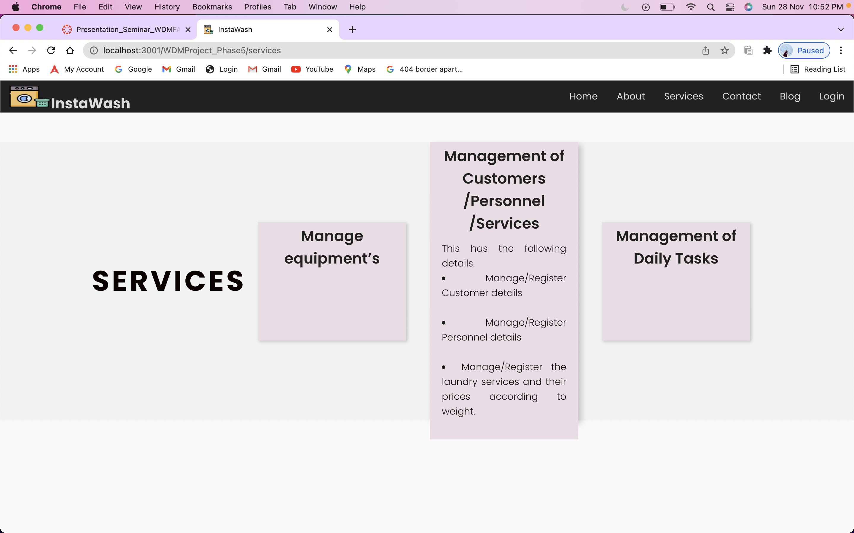
PROJECT 5 Demo
Page : Services
Services page explains the services offered at insta wash

Slide 6
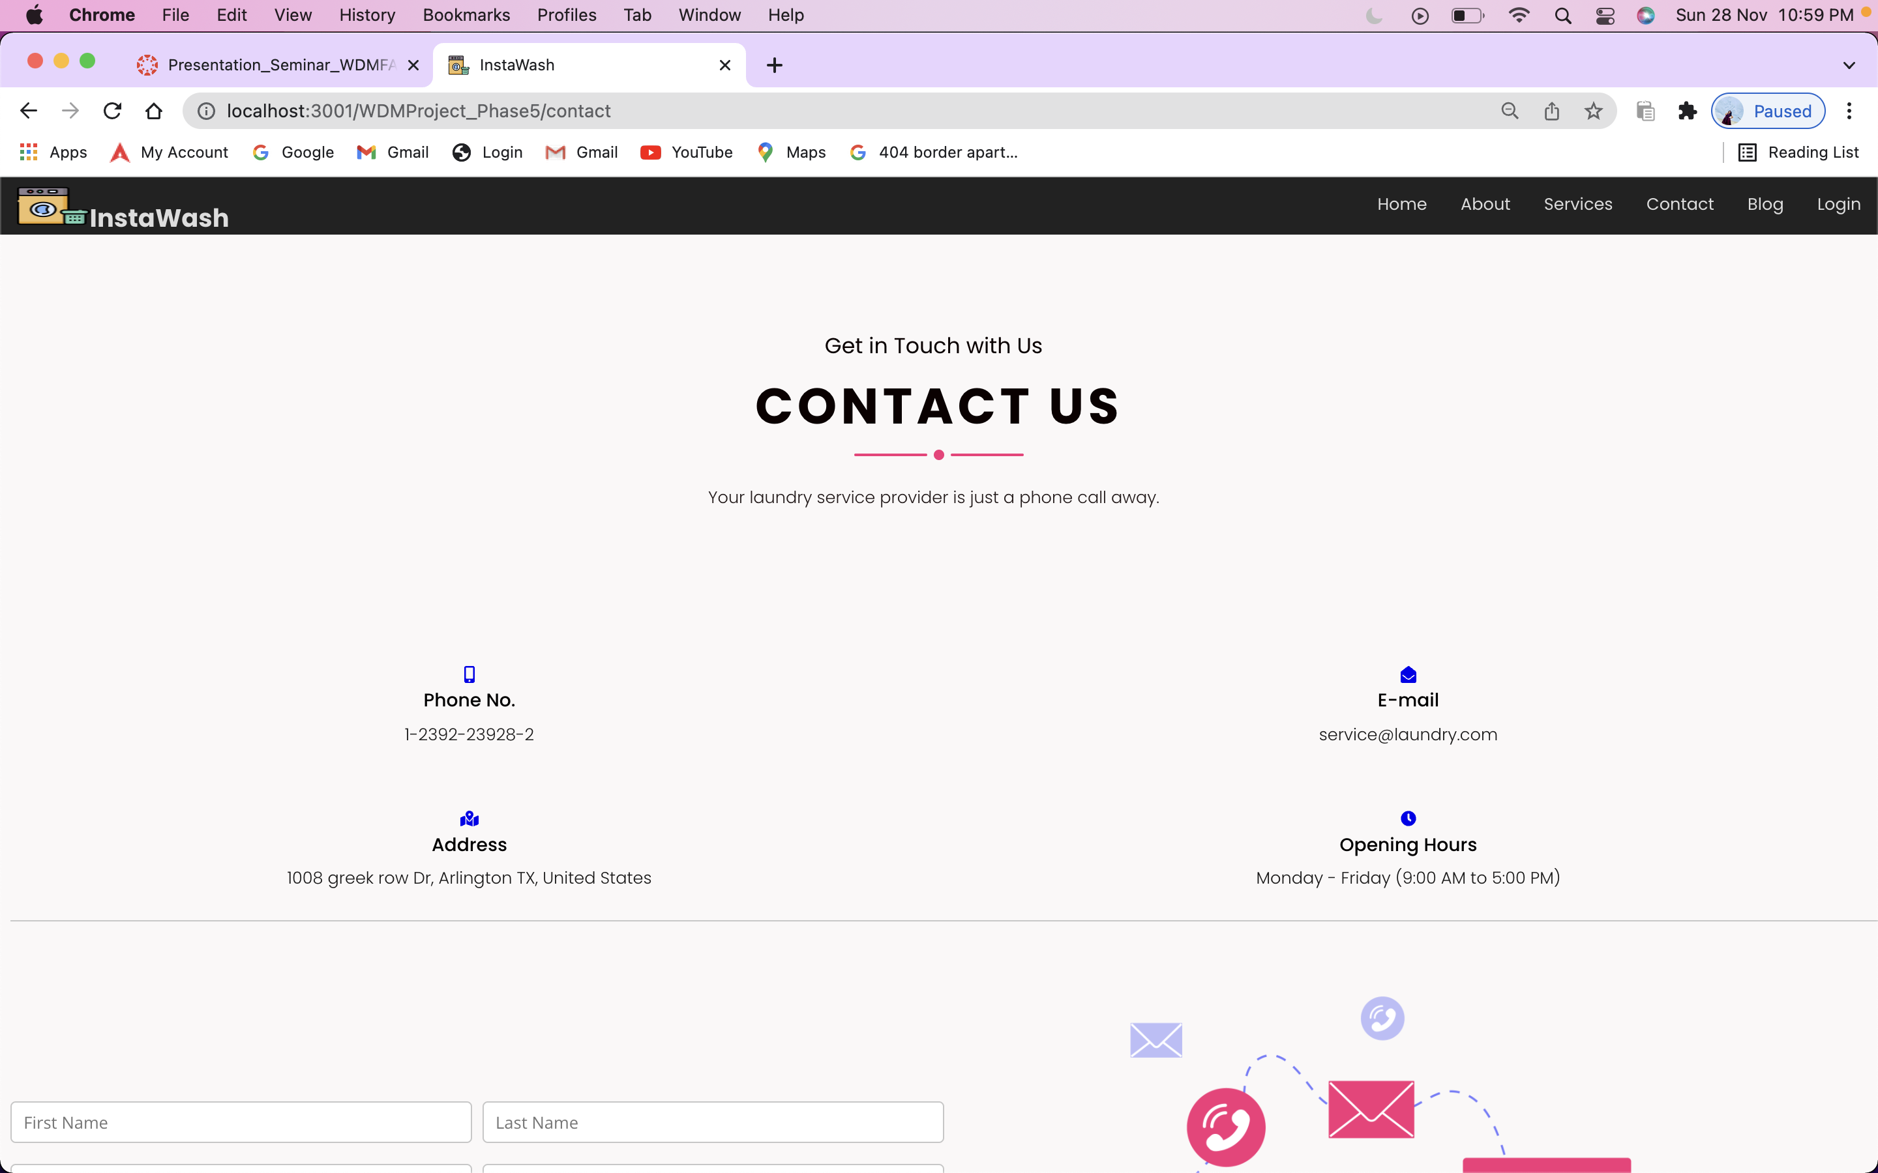
PROJECT 5 Demo
Page : Contact
Contact page provides the contact information of the insta wash system.
User can also reach out to the admin by contact page form. It triggers a mail to the admin with the message.

Slide 7
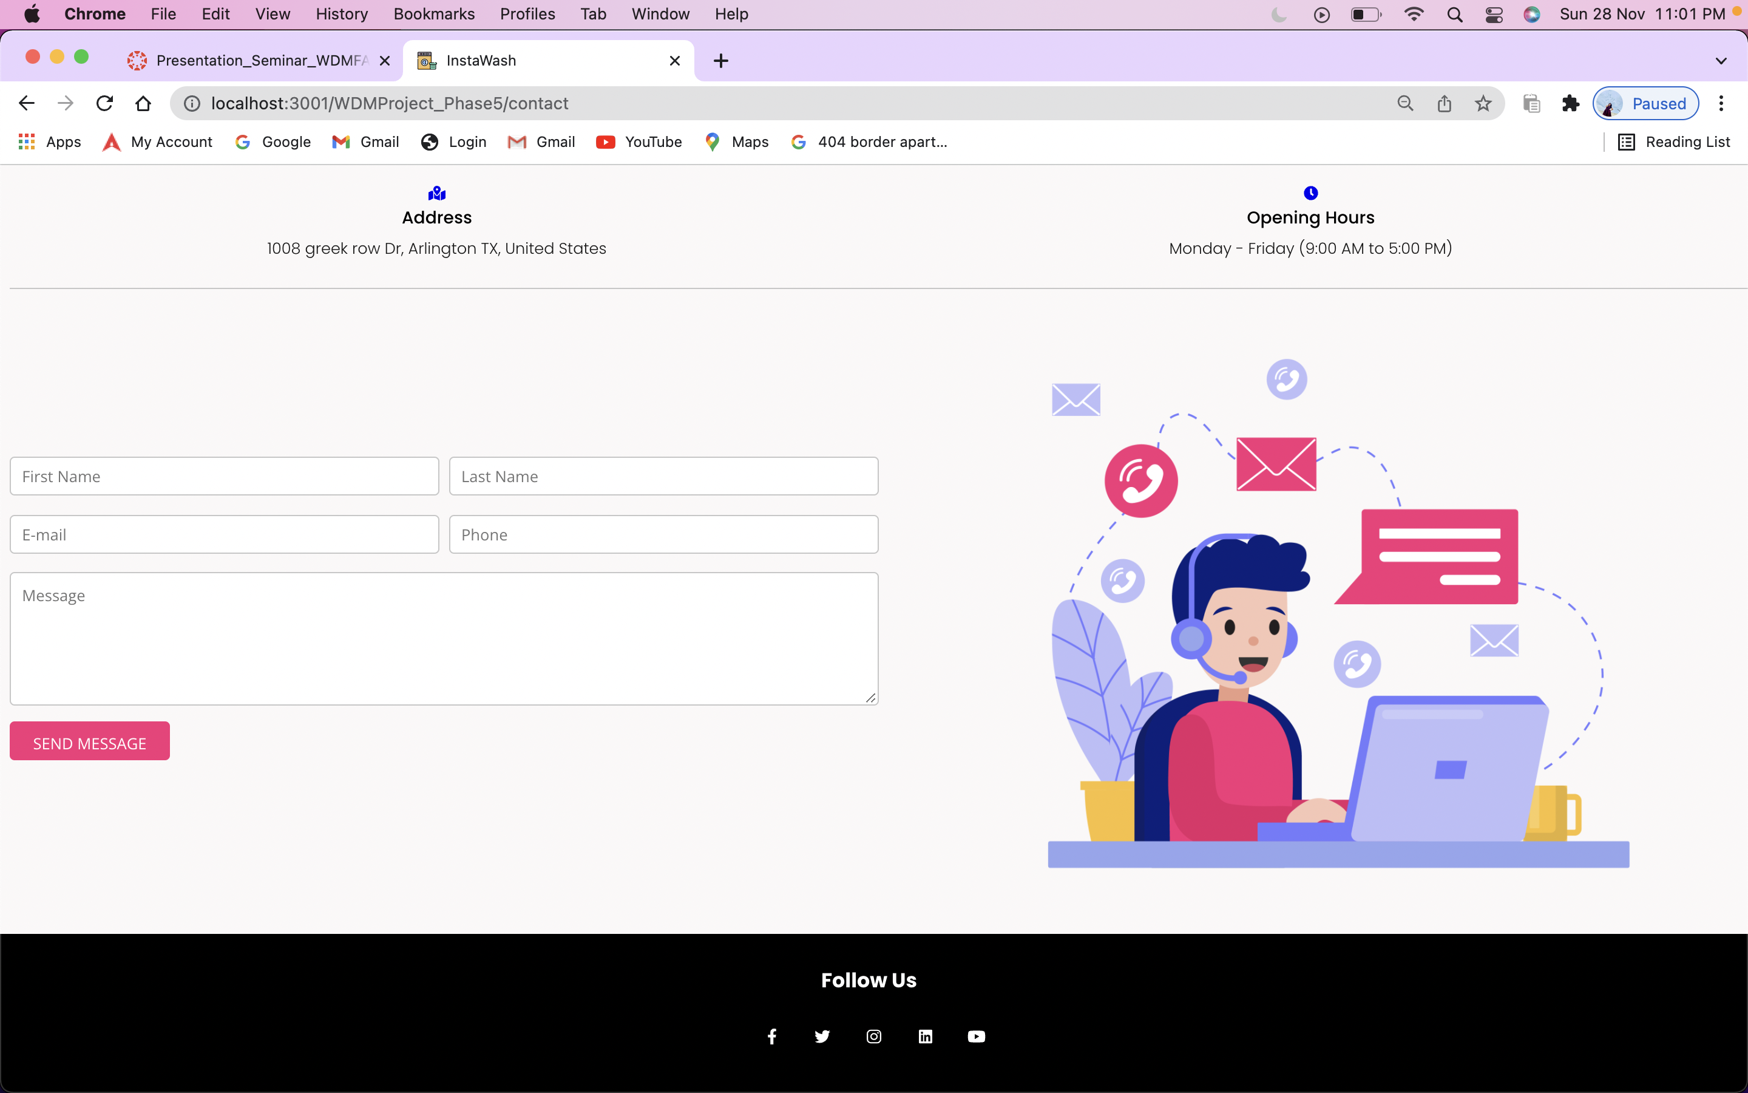
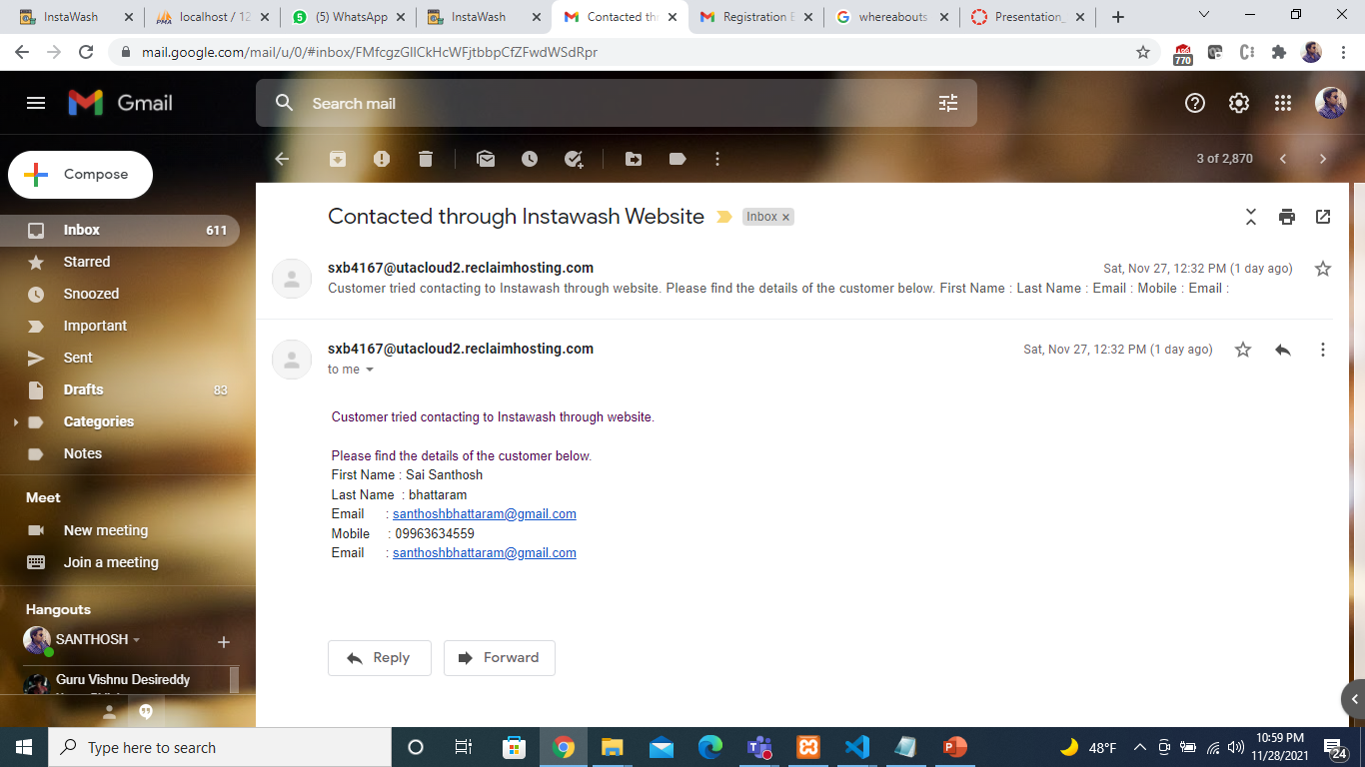
PROJECT 5 Demo
Page : Contact

Slide 8
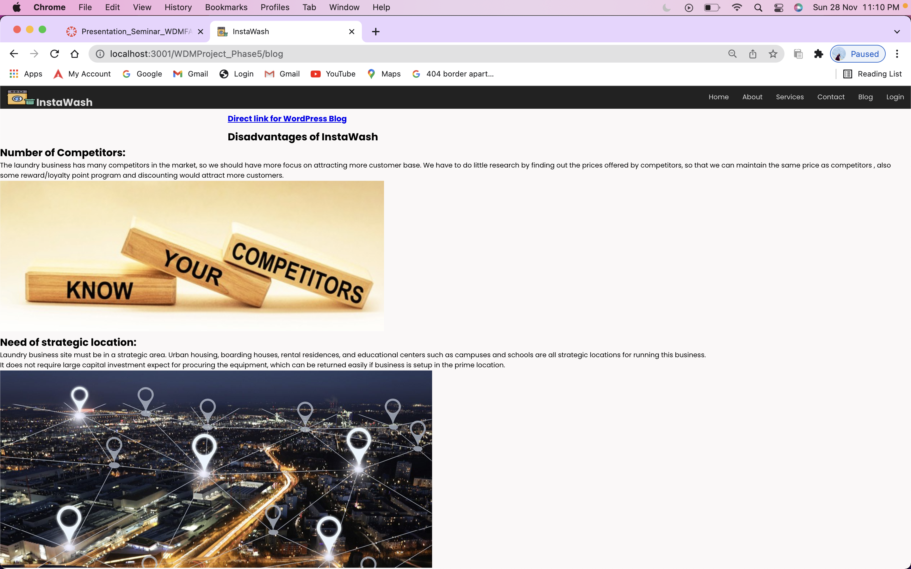
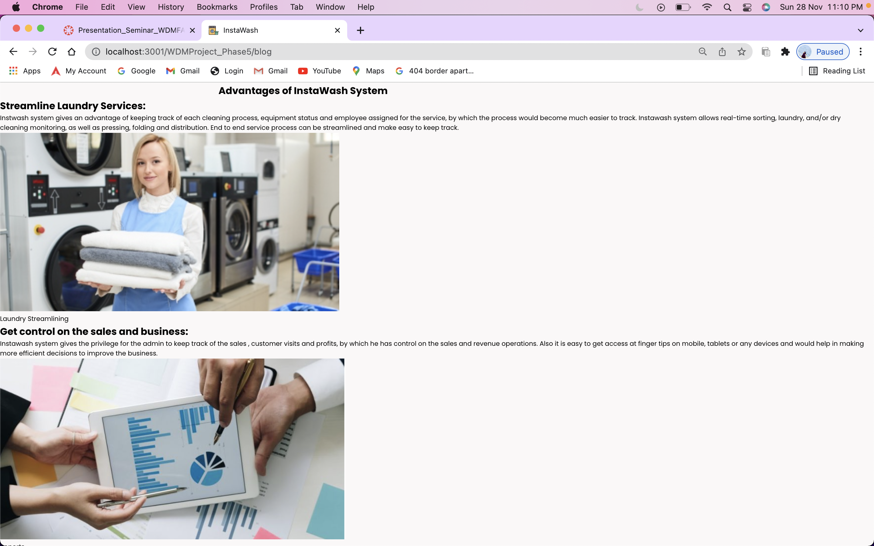
PROJECT 5 Demo
Page : Blog
Blog has been integrated to react using word press api.

Slide 9
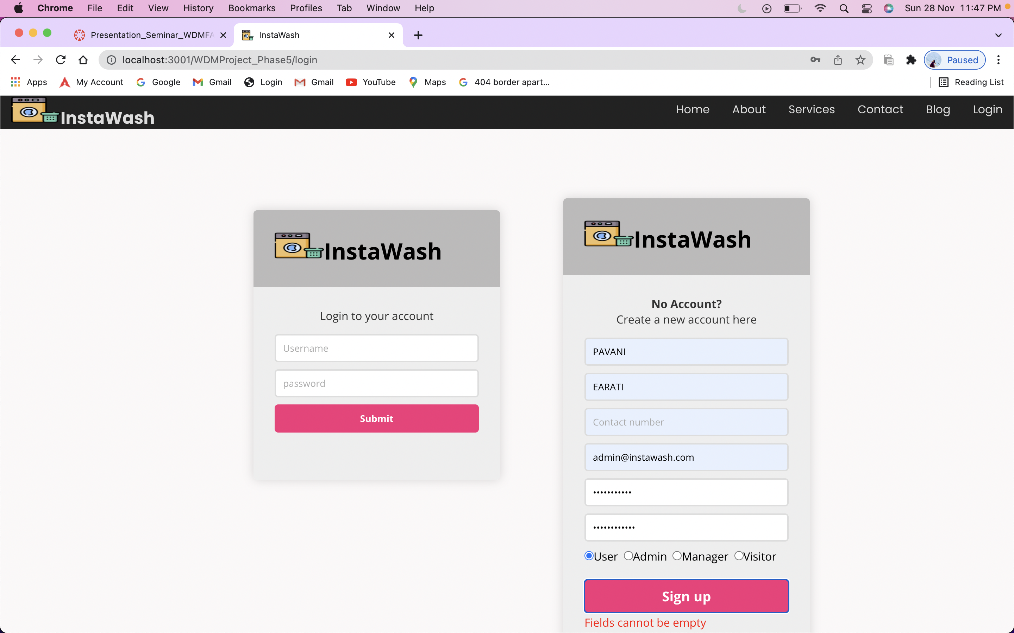
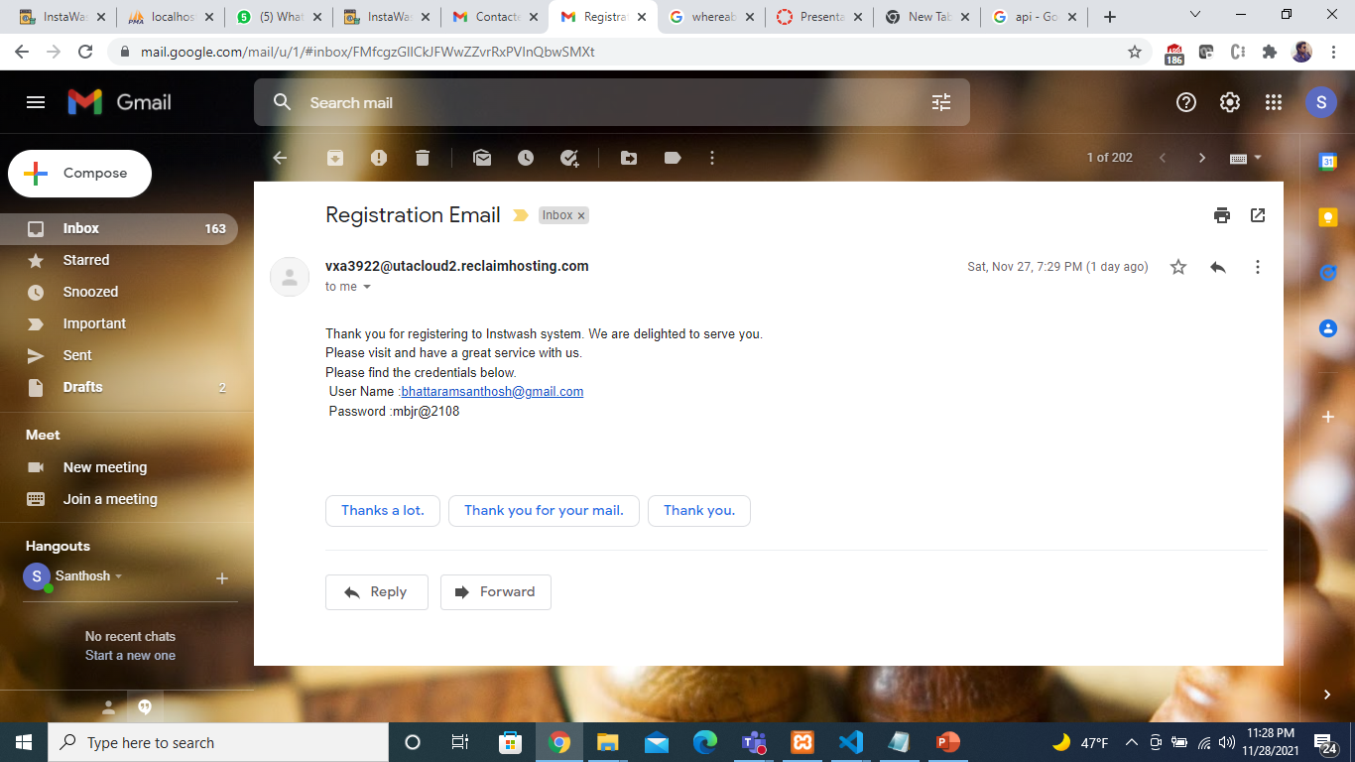
PROJECT 5 Demo
Page :Registration
Registration form is used to sign up for the Insta wash.
We have included form validations like email validation, empty field, password and verification for existing user.
An email would be triggered to the registered user with credentials.

Slide 10
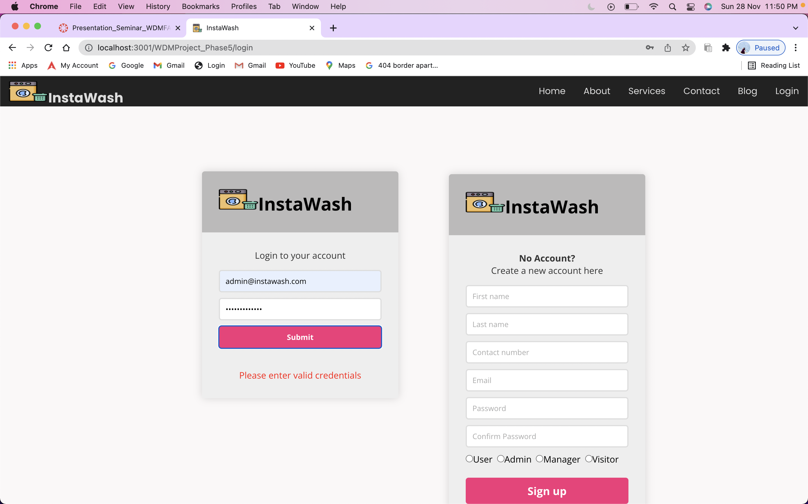
PROJECT 5 Demo
Page : Login
Login form is used for logging into the system based on role.
Login page redirects to the respective pages based on the role tagged in the system.

Slide 11
PROJECT 5 Demo
Pages after login

Slide 12
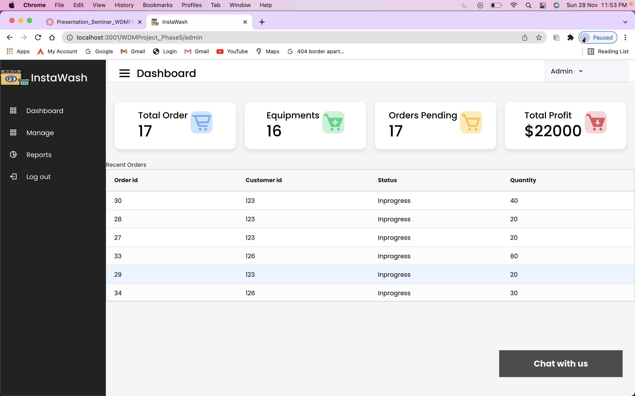
PROJECT 5 Demo
Page : Admin Page- Admin Dashboard
Admin has access to admin dashboard, manages, report section.
Admin dashboard has summary of order and inventory and list of recent orders.

Slide 13
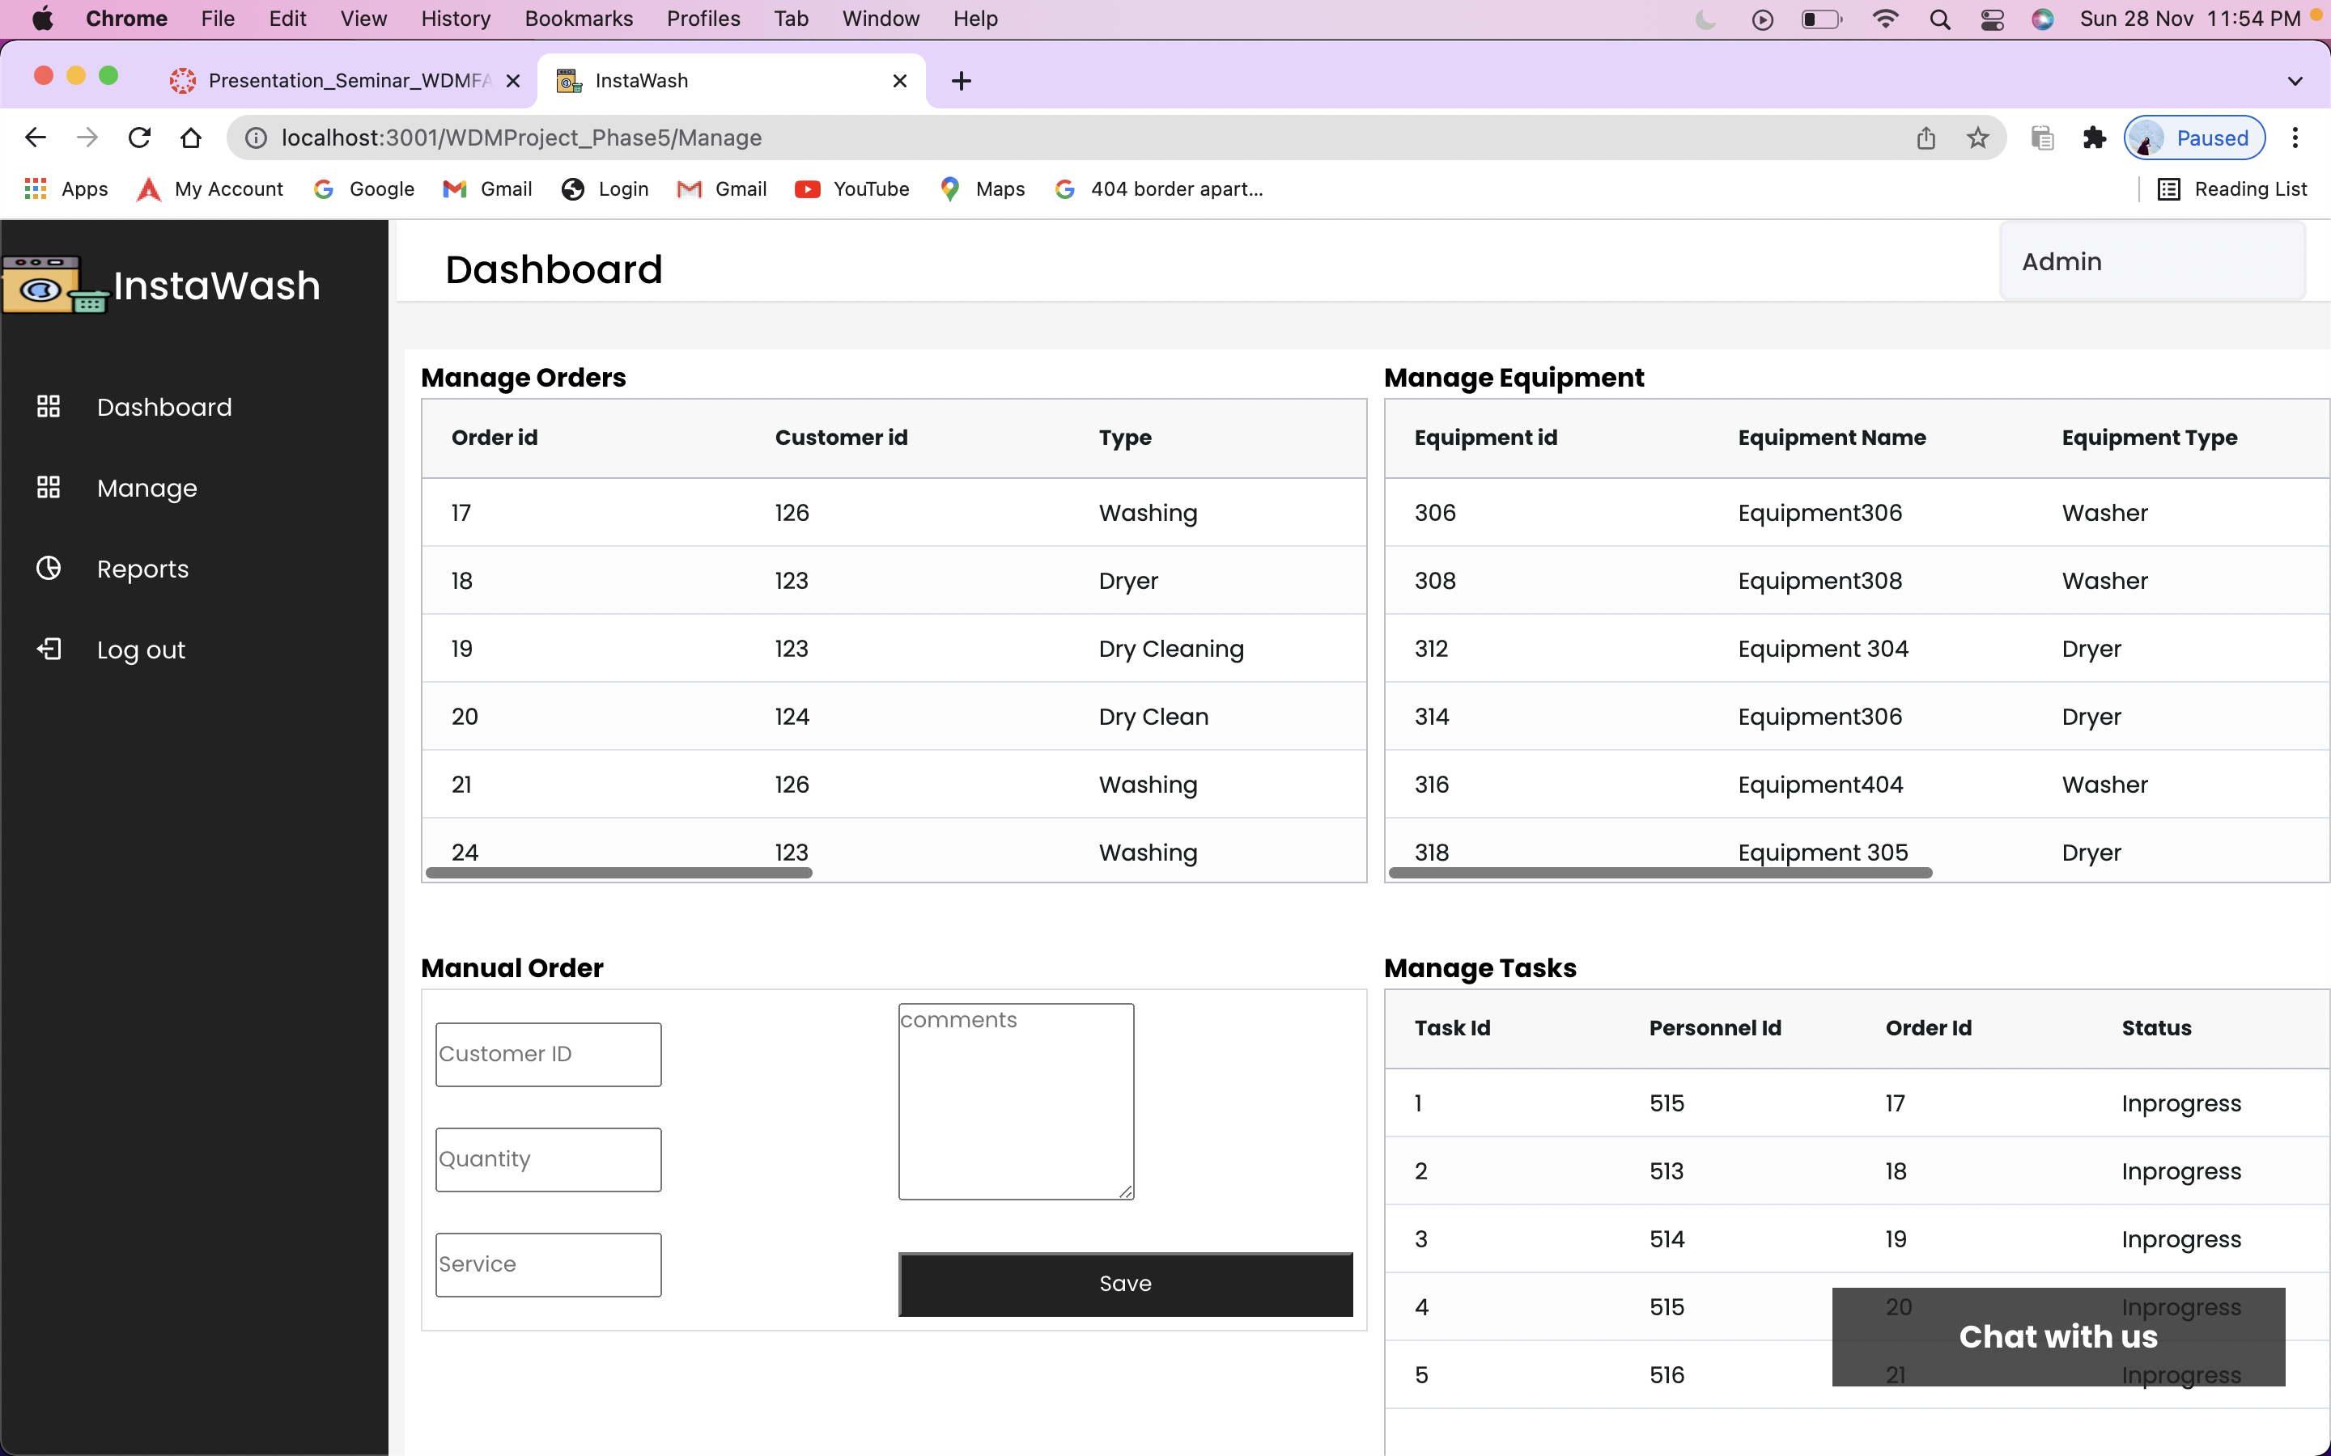
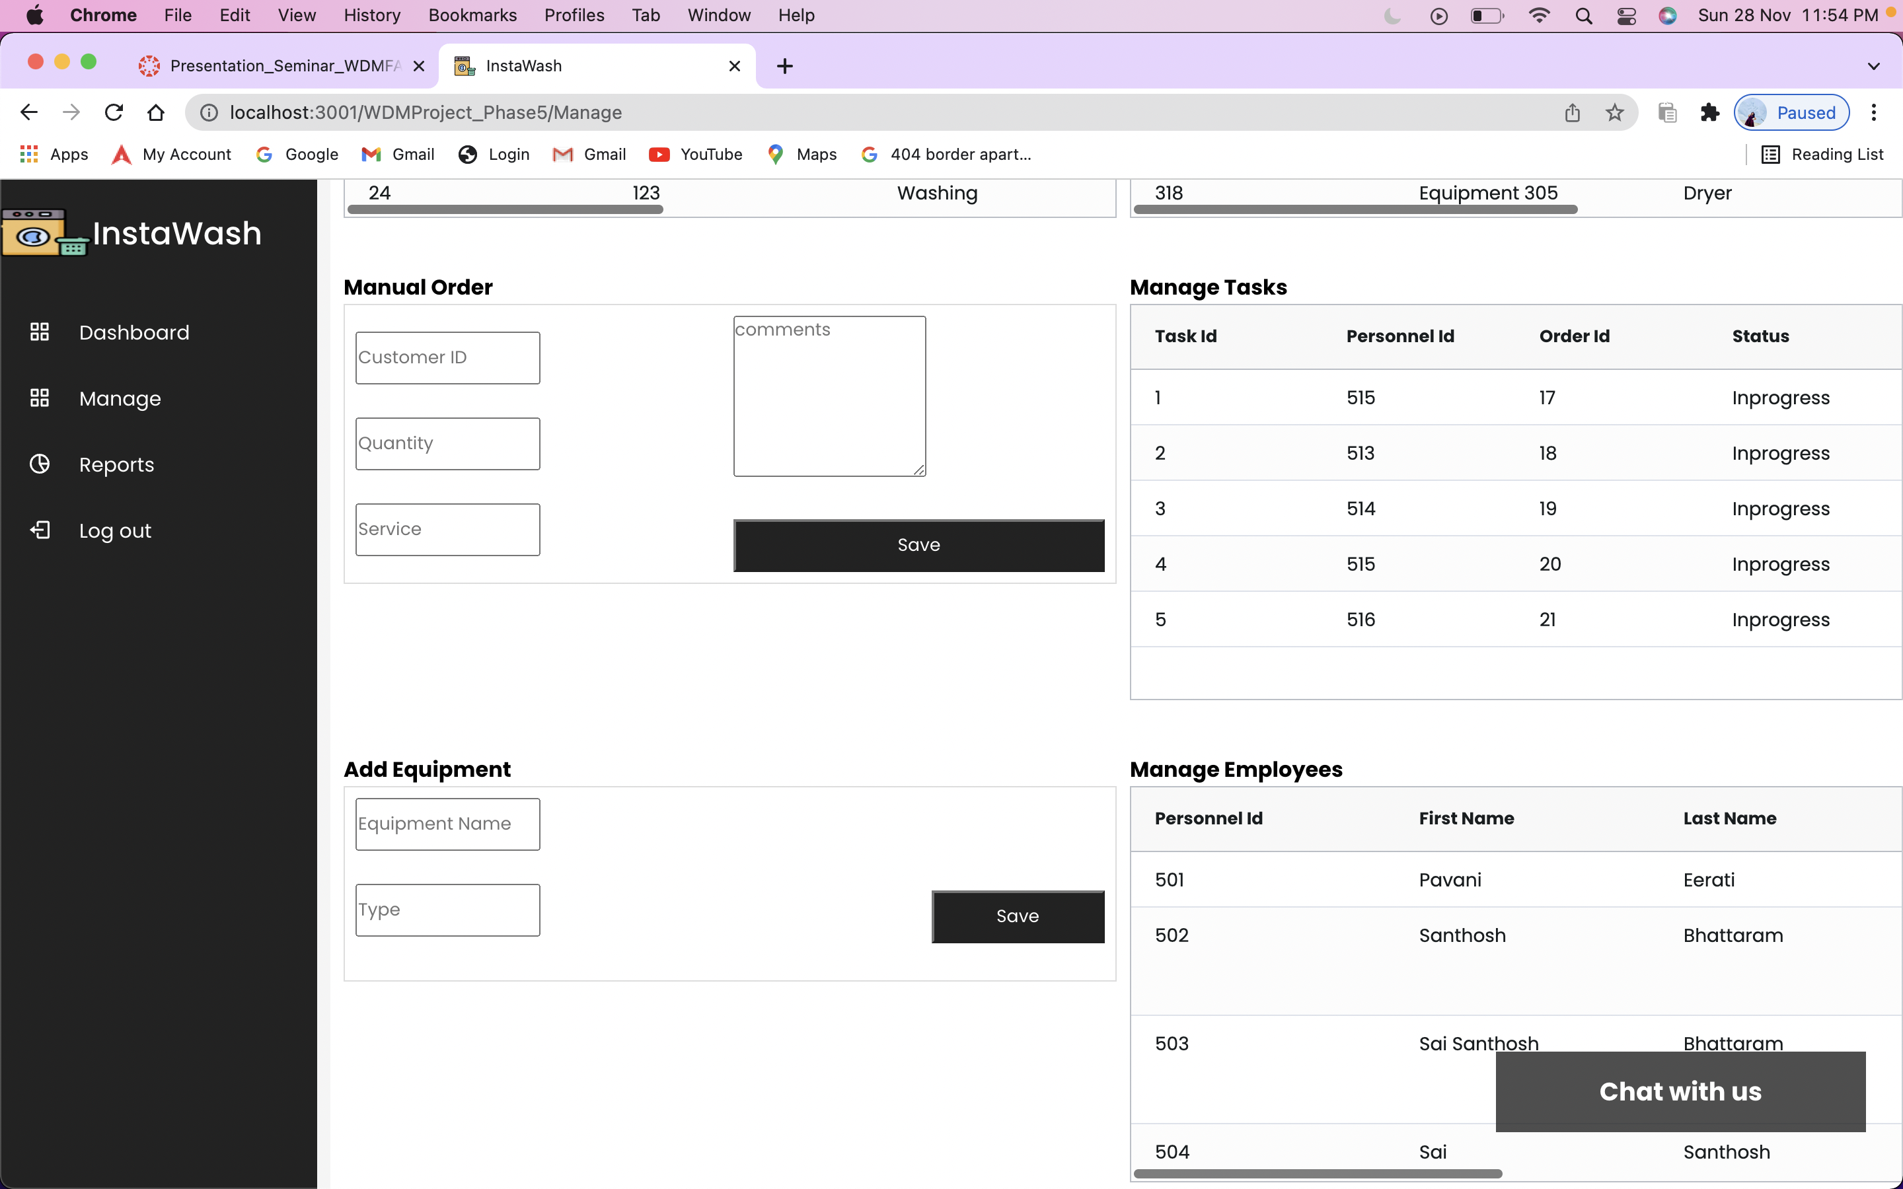
PROJECT 5 Demo
Page : Admin Page- Manages
Manages page has the option to manage the equipment's, orders, tasks, personnel.
Also has the access to add, update and delete equipment’s, orders etc.

Slide 14
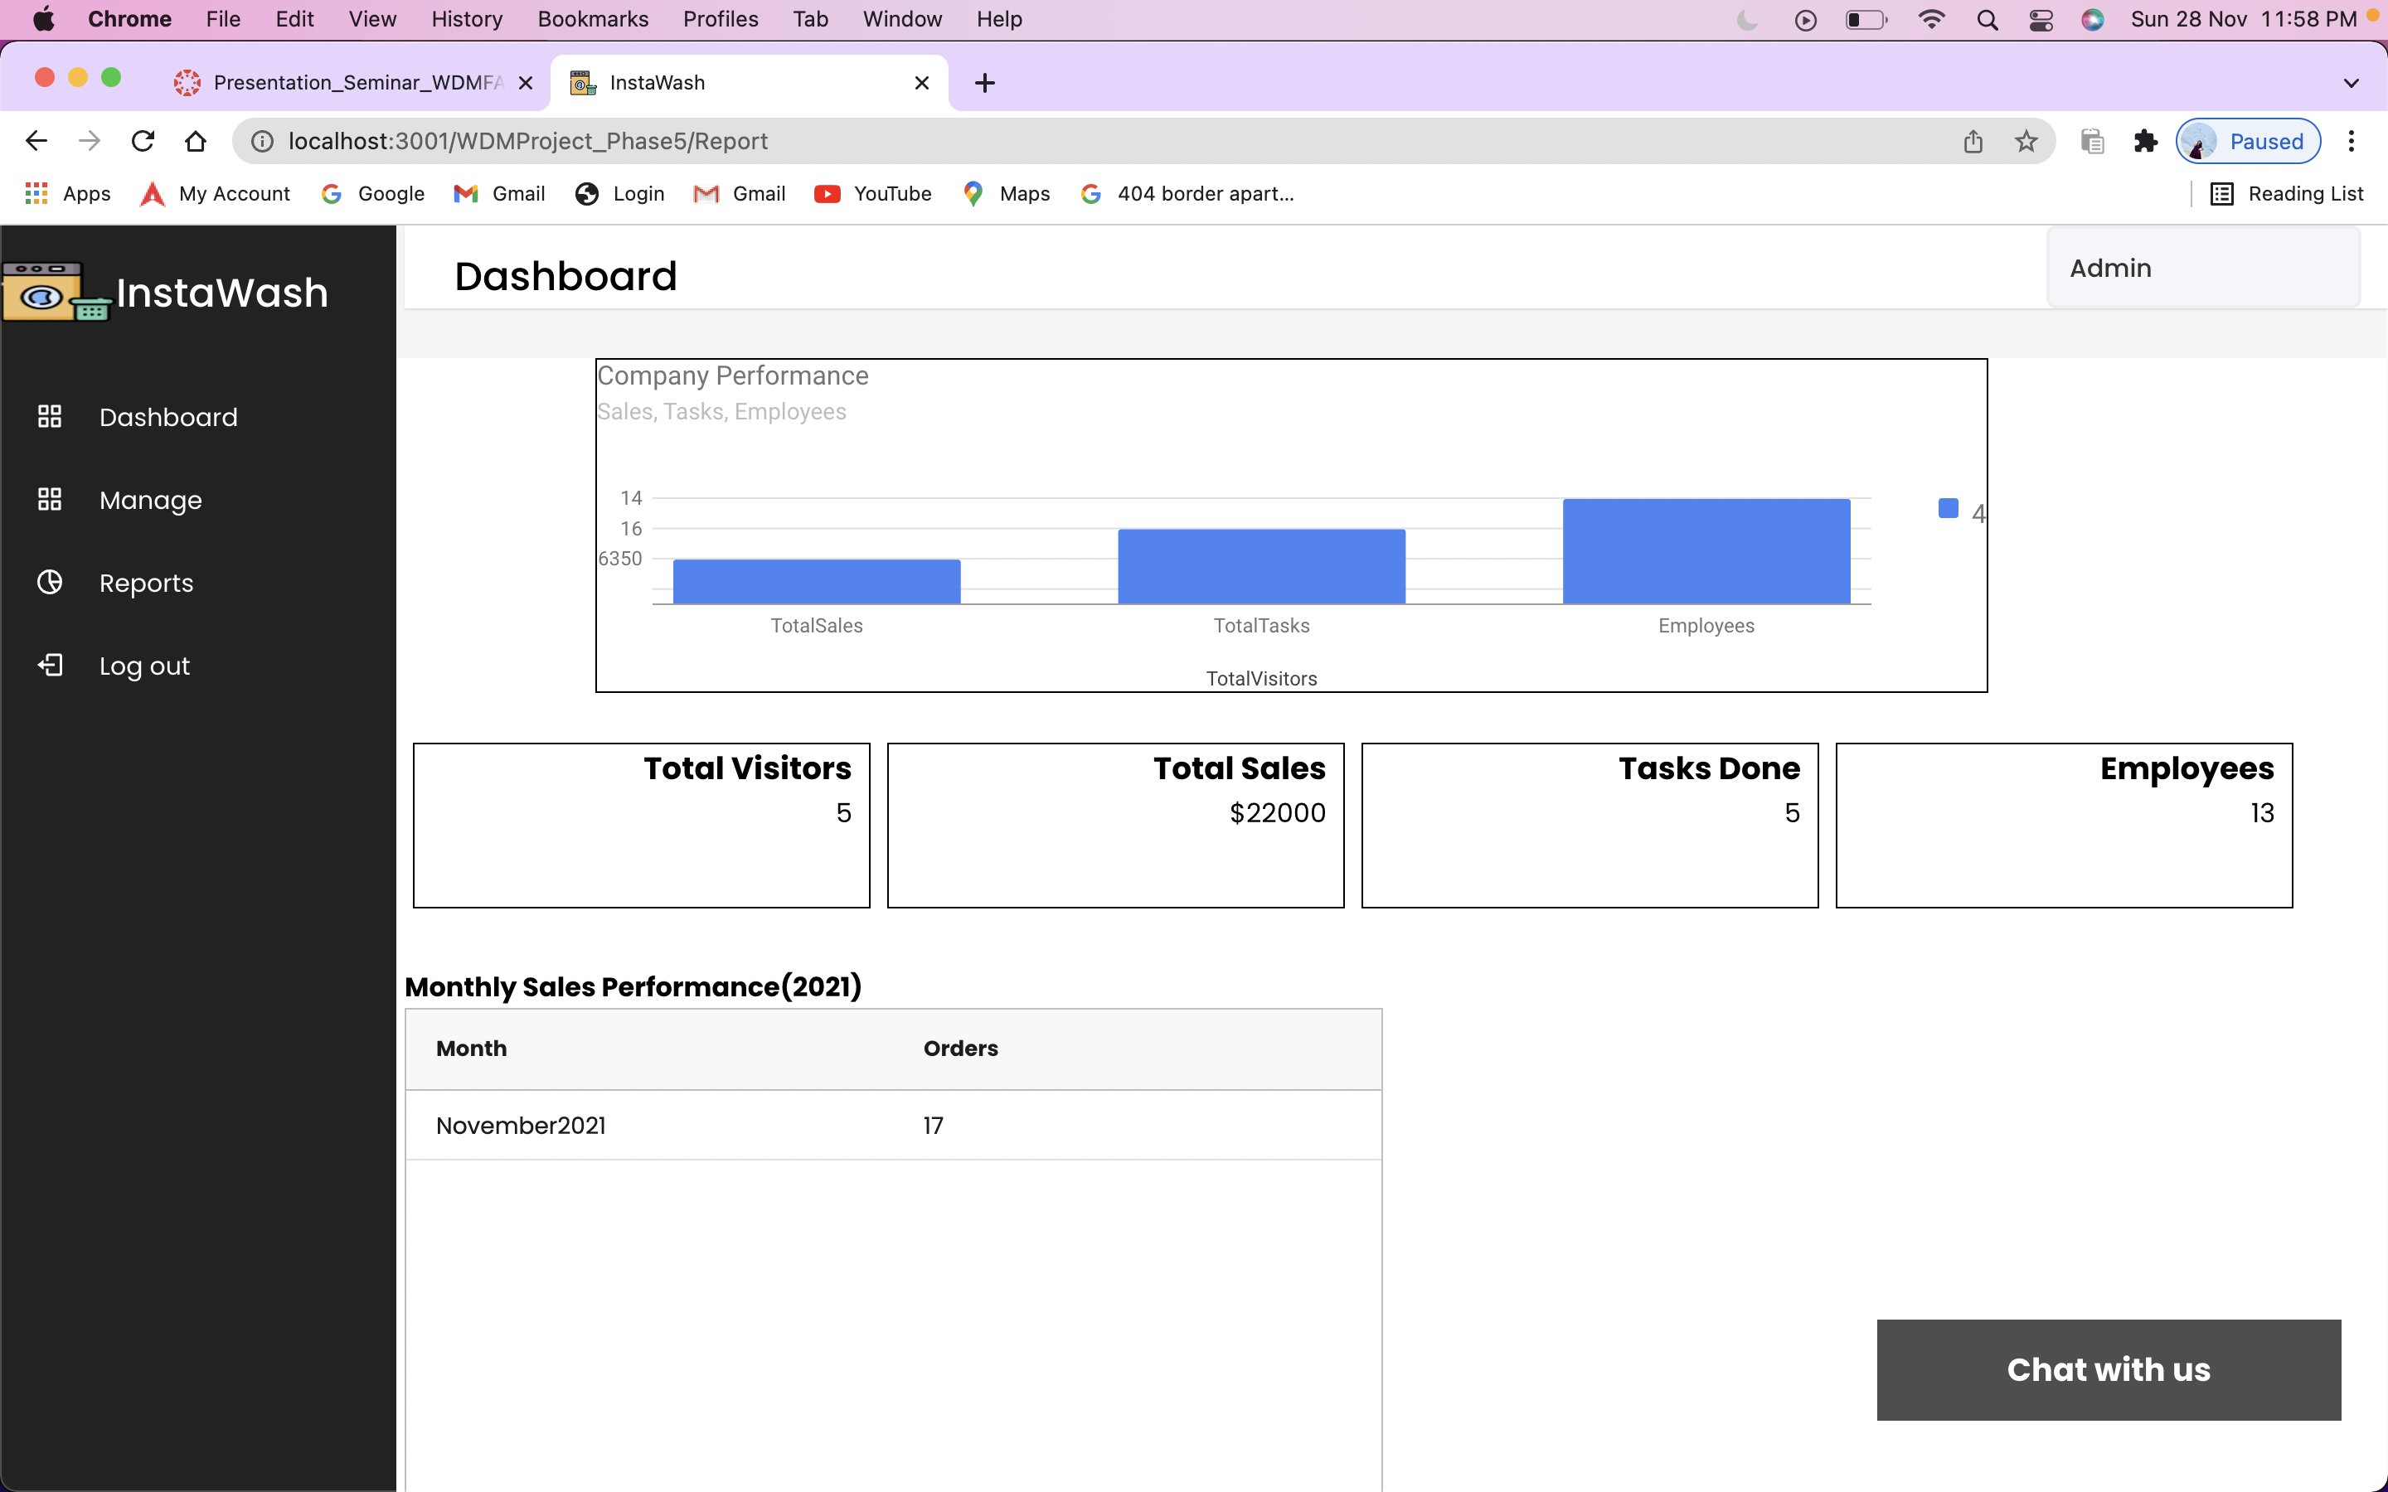
PROJECT 5 Demo
Page : Admin Page- Reports
Report page has the charts and sales performance of the company

Slide 15


PROJECT 5 Demo
Page : Manager
Manages page has the option to manage the equipment's, orders, tasks, personnel.
Also has the access to add, update and delete equipment’s, orders etc.

Slide 16
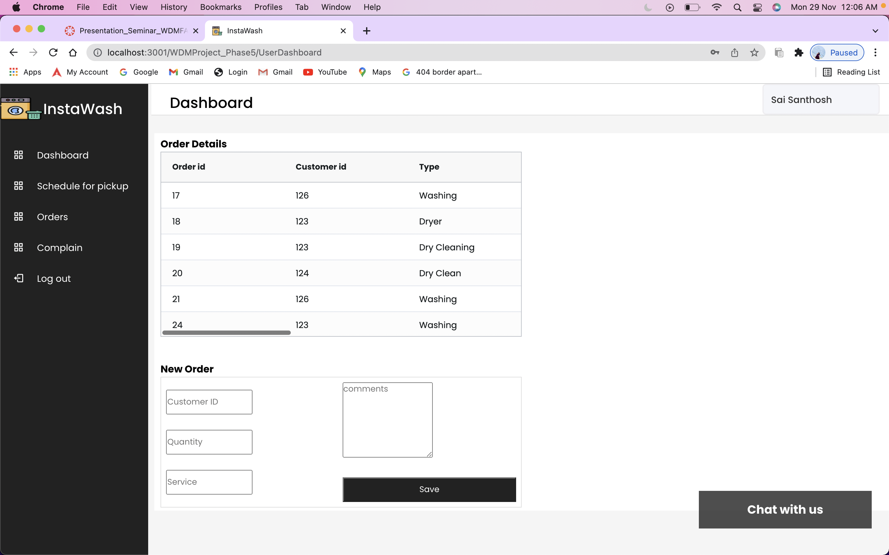
PROJECT 5 Demo
Page : User-orders
This page has user orders list and an option to create manual order.

Slide 17
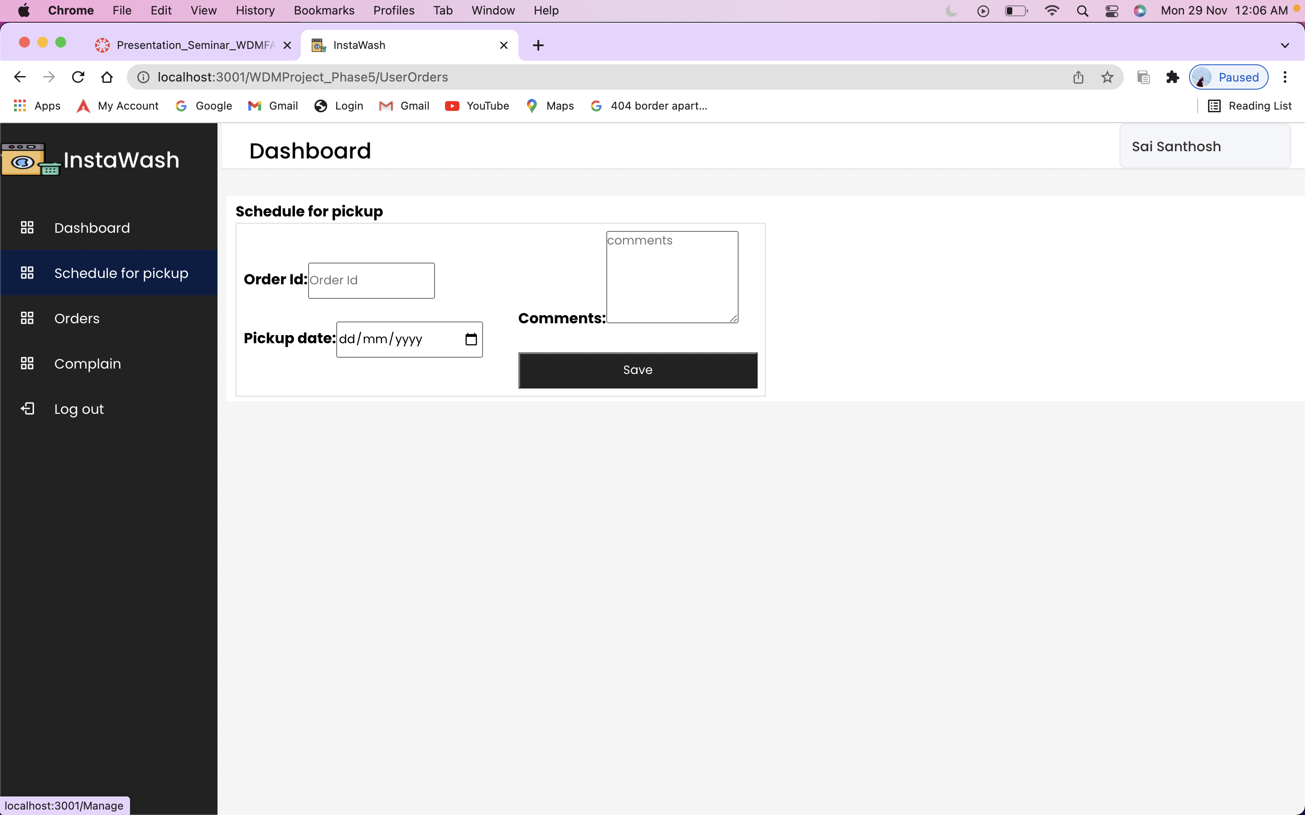
PROJECT 5 Demo
Page : User-Schedule for pickup
In this page has an option to Schedule a pickup based on their order number.

Slide 18
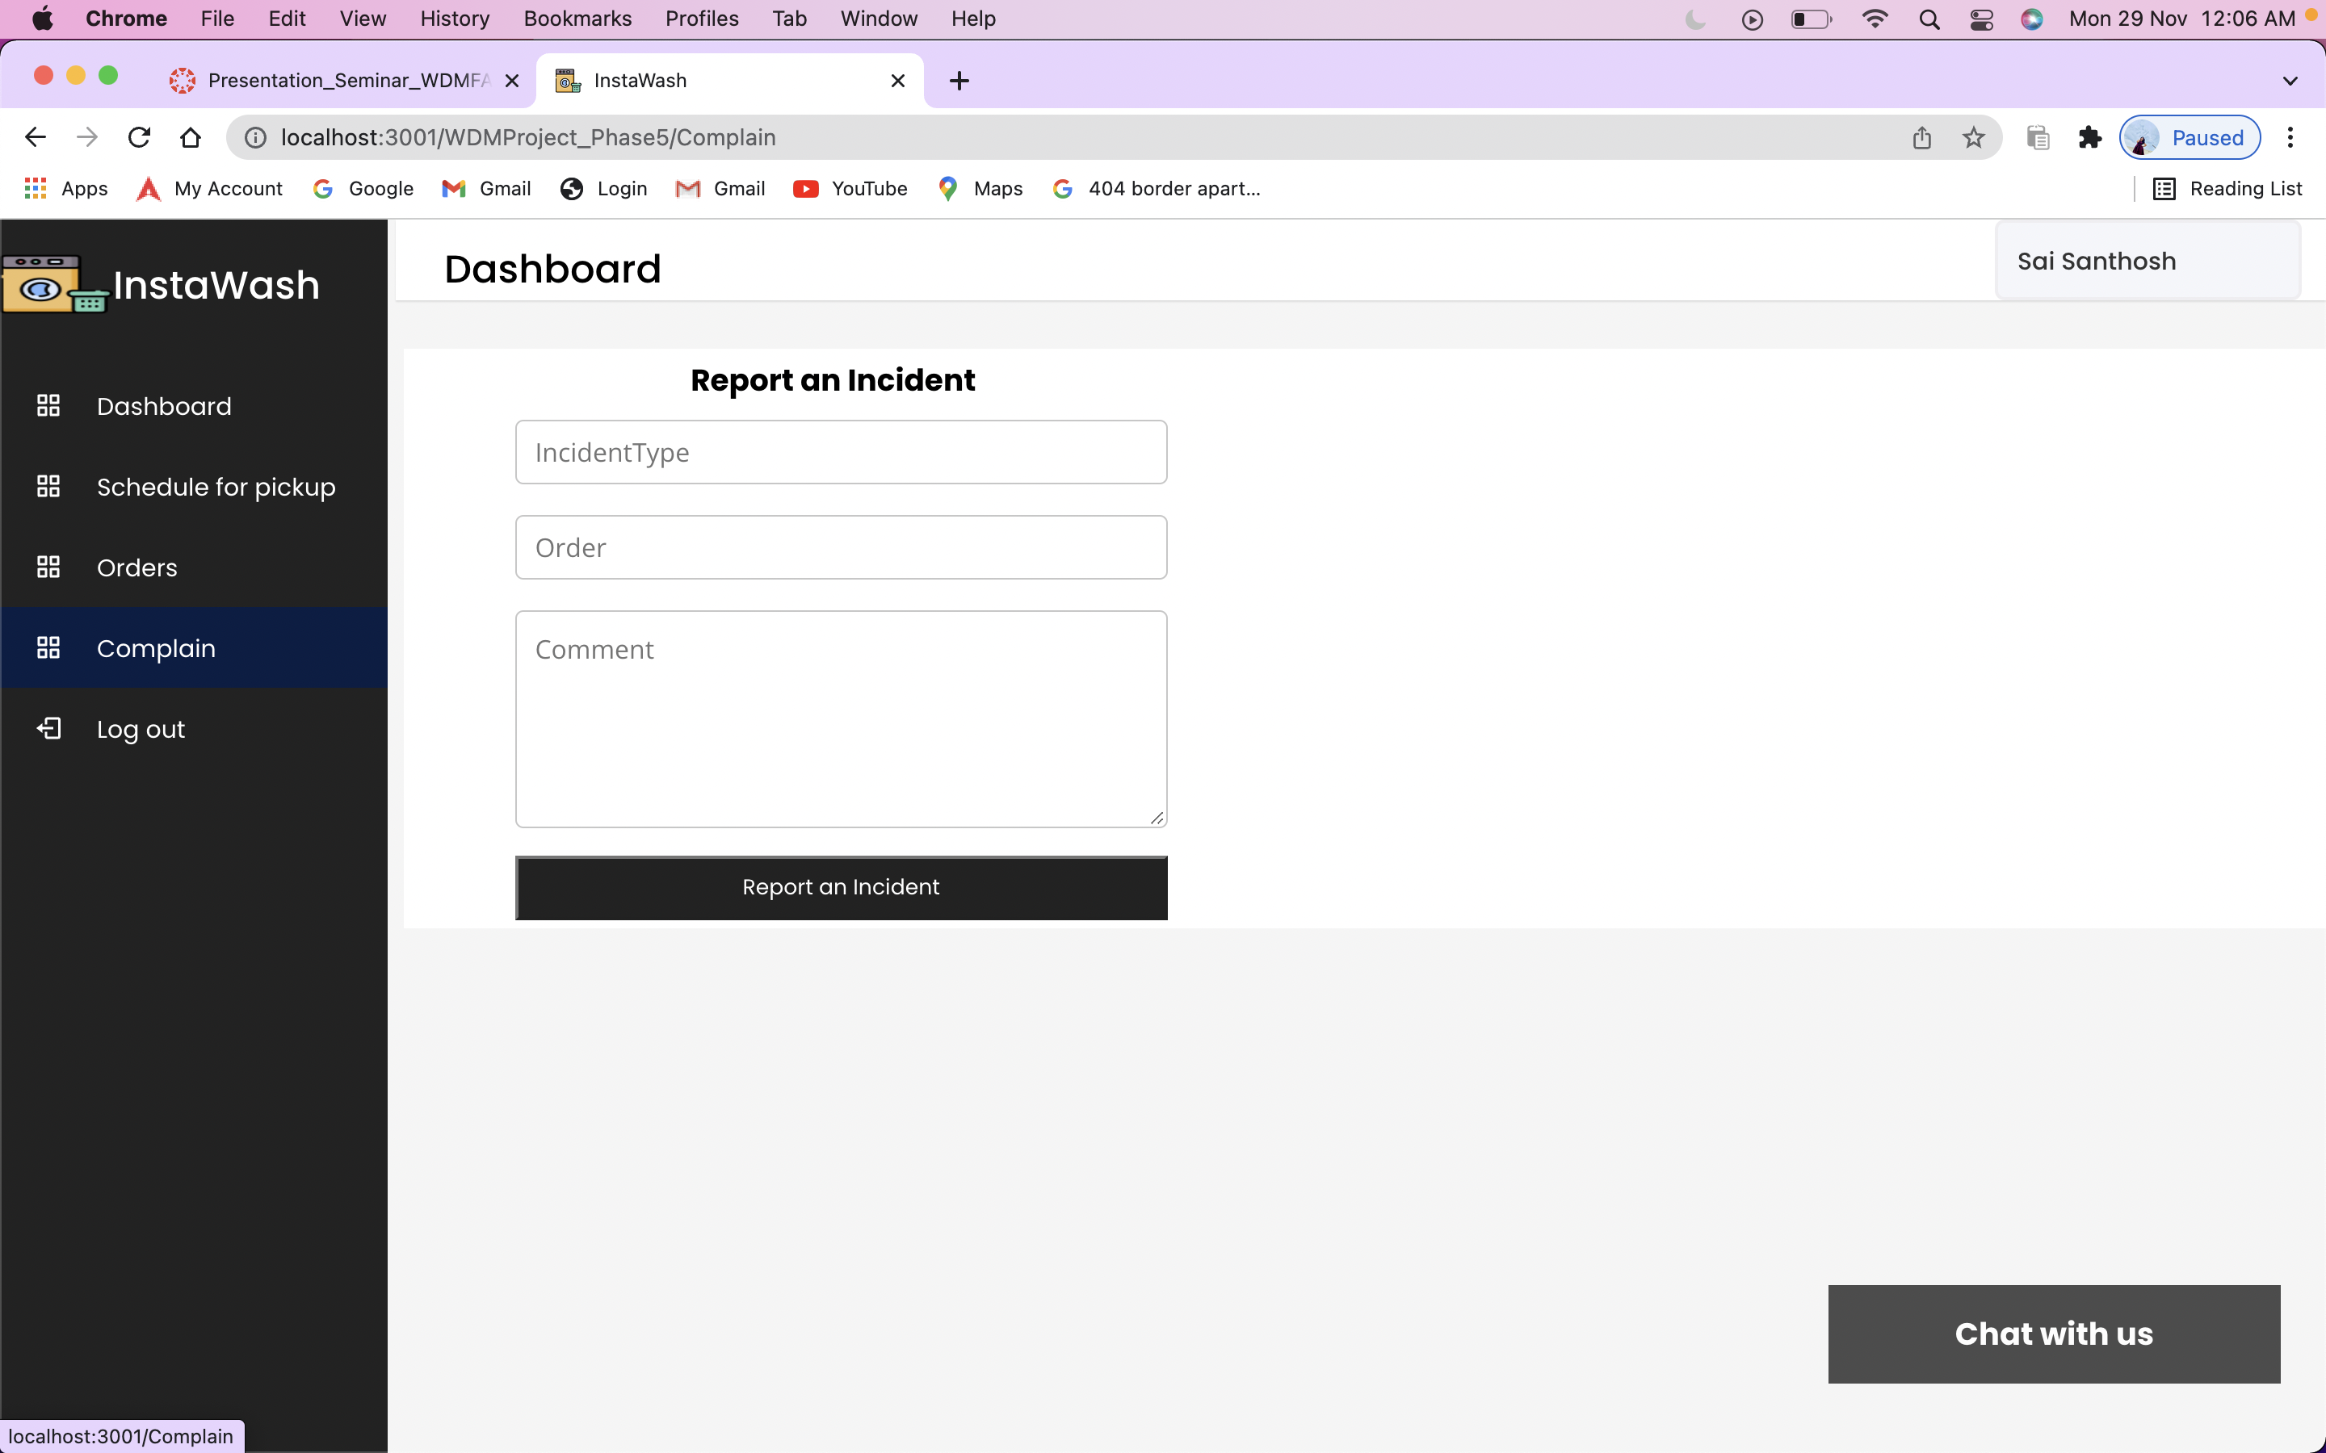
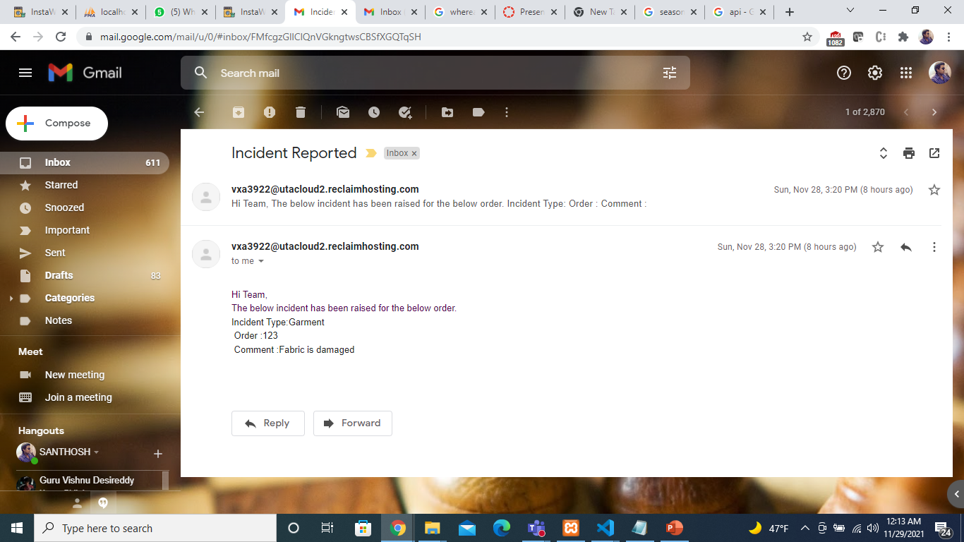
PROJECT 5 Demo
Page : User-Report an incident
This page is used to raise an incident to the admin where user us the order number and give description.
After submitting the admin gets the report of the incident by the mail.

Slide 19
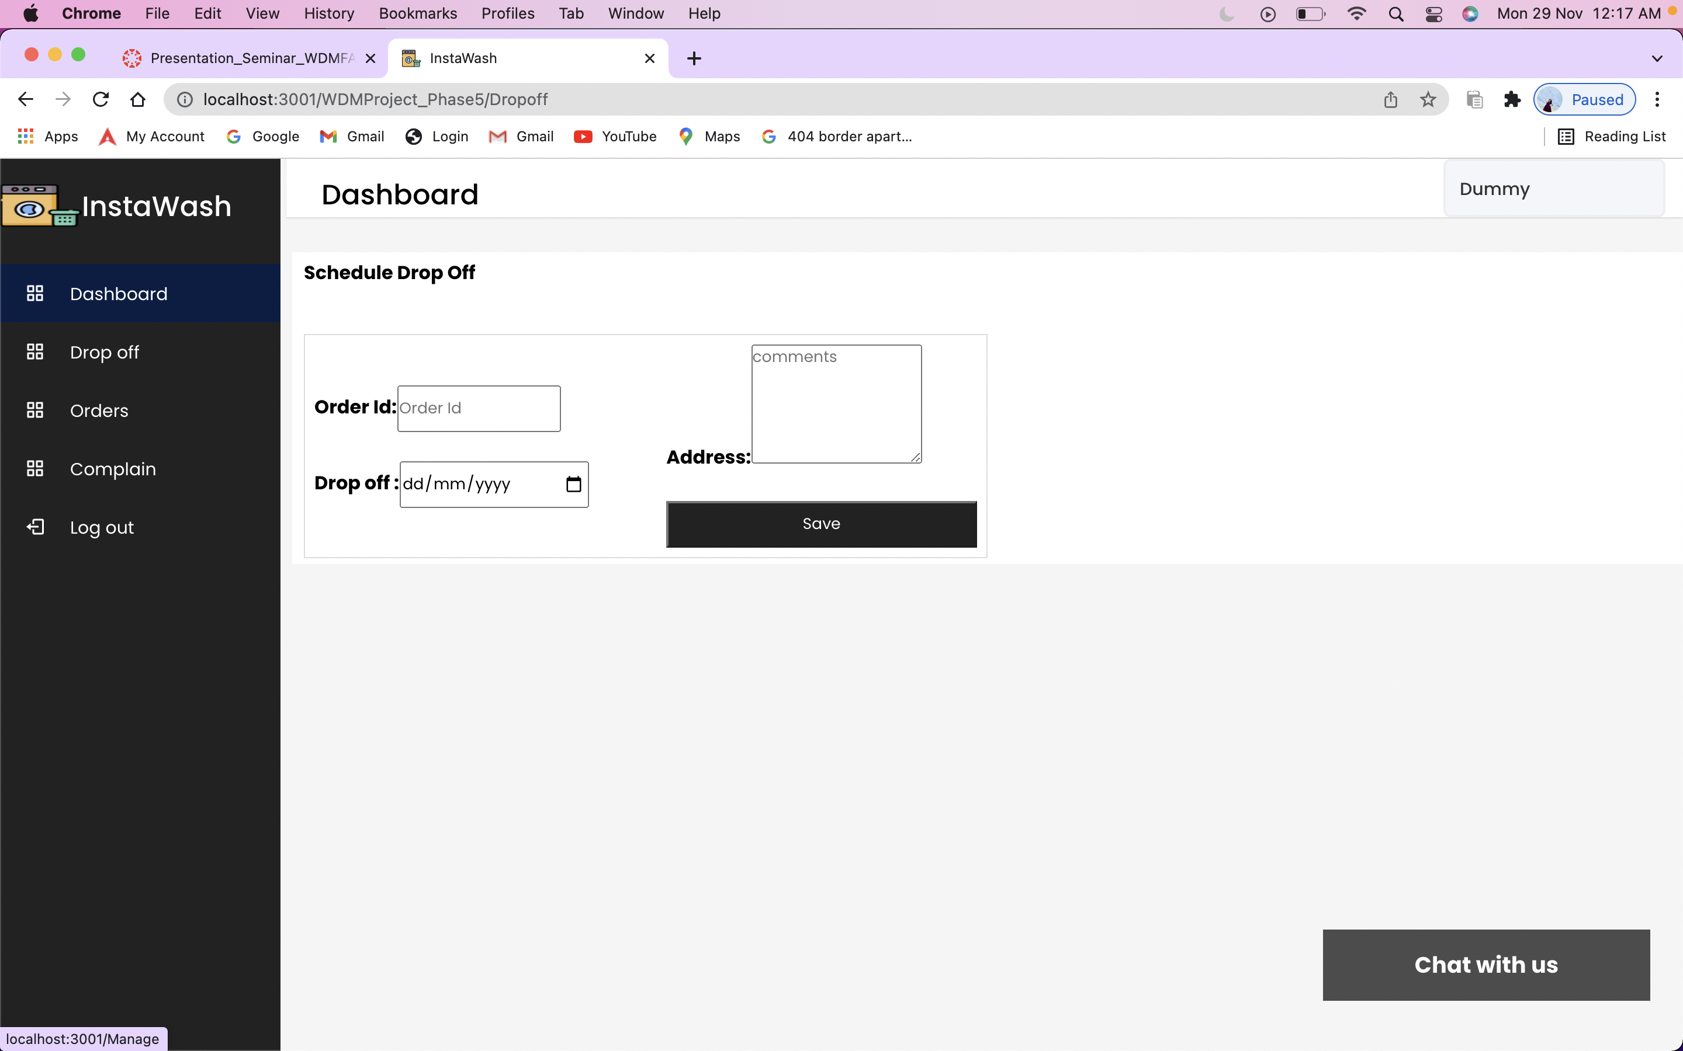
PROJECT 5 Demo
Page : Visitor-Drop off
Visitor has an option to Schedule a drop off for the order.

Slide 20
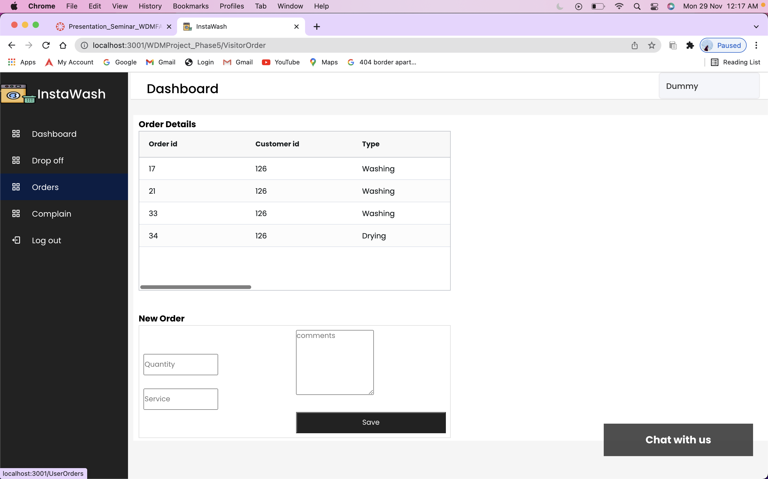
PROJECT 5 Demo
Page : Visitor-Orders
Visitor can view orders and create a new orders using this page.

Slide 21
PROJECT 5 Demo
Page : Visitor-Report an incident
This page is used to raise an incident to the admin where user us the order number and give description.
After submitting the admin gets the report of the incident by the mail.

Slide 22
PROJECT 5 Demo
Node/ Chat

Slide 23
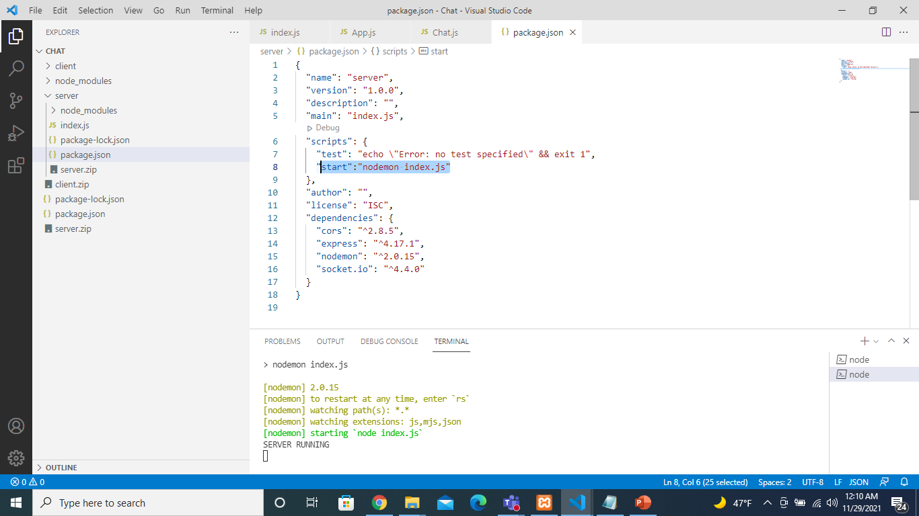
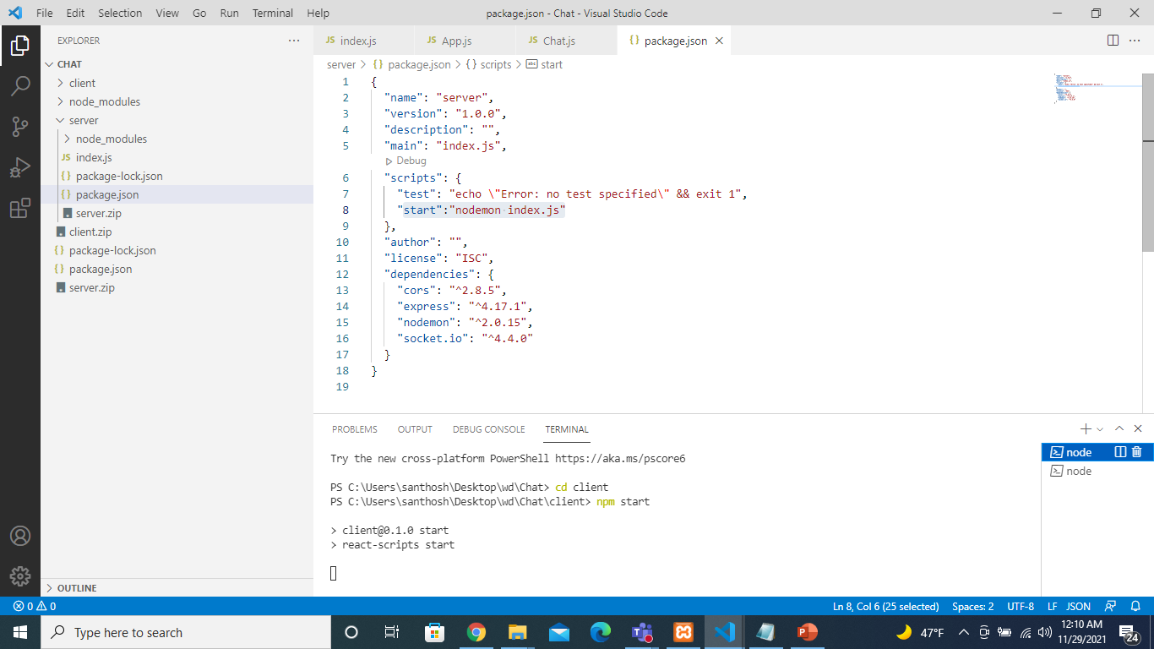
PROJECT 5 Demo
Page : Chat
Chat has been implemented using node js and socket.io.
It makes an asynchronous communication through socket.

Slide 24
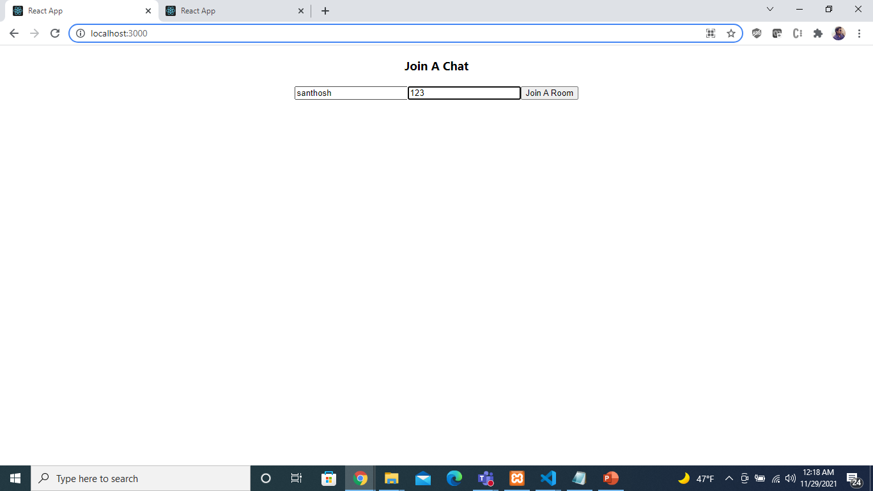
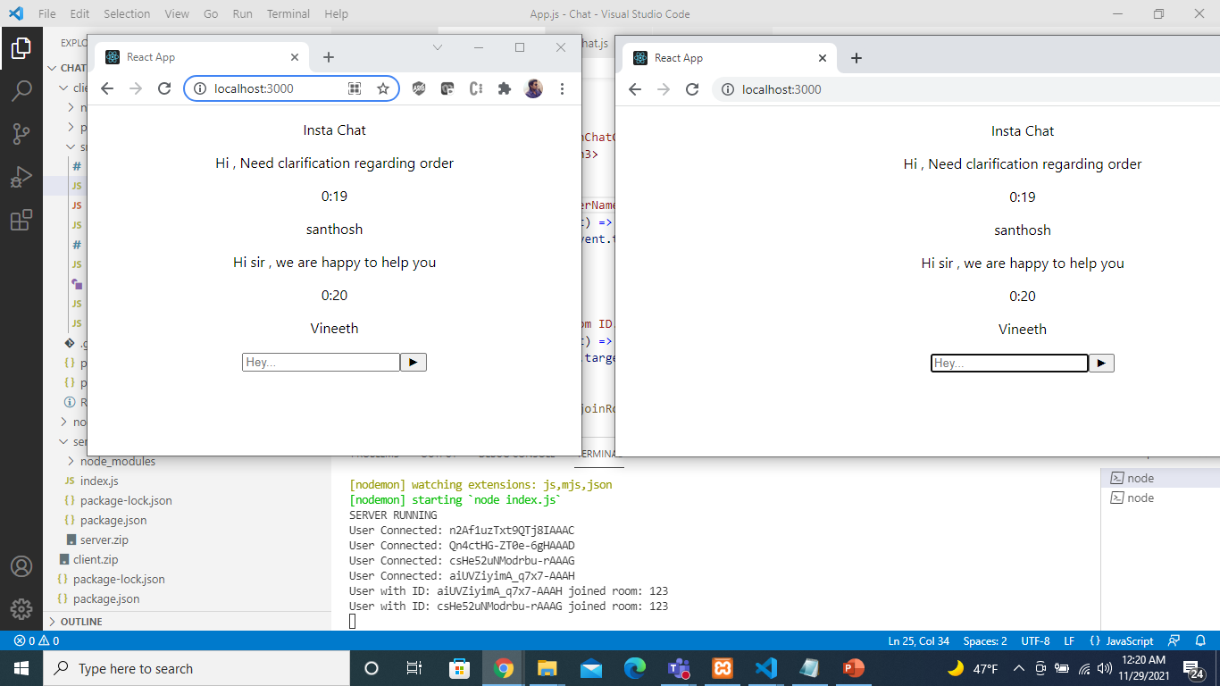
PROJECT 5 Demo
Page : Chat

Slide 25

Thank You

